Slide 1


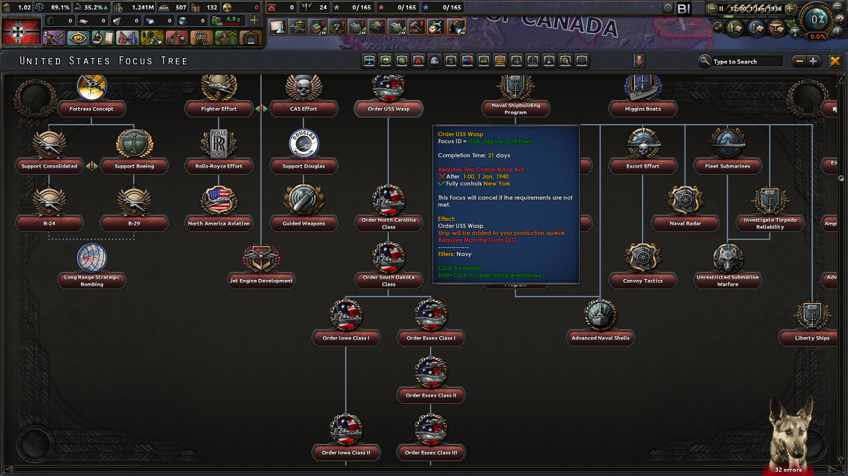
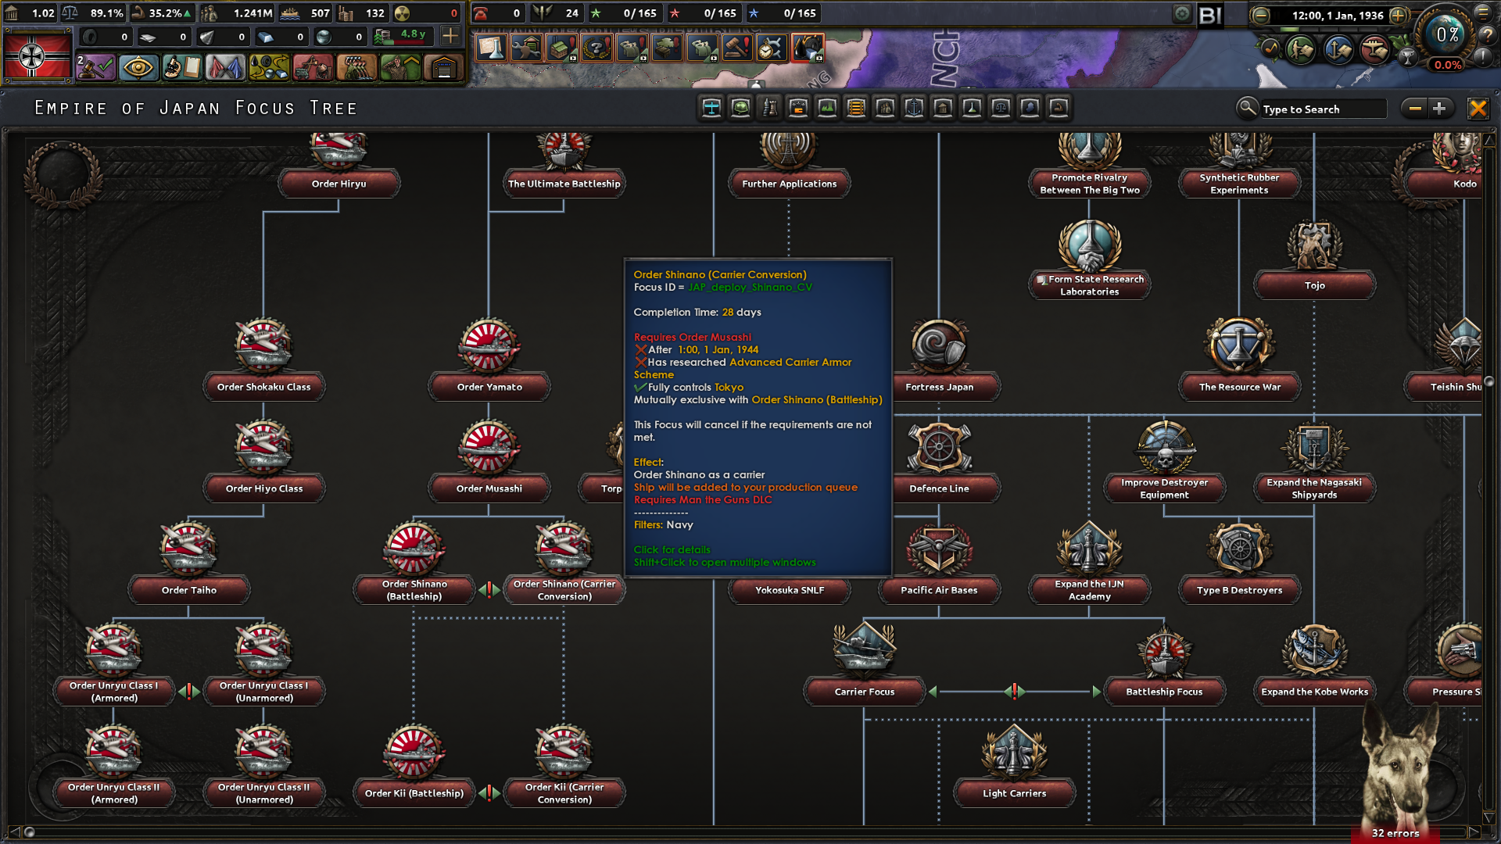
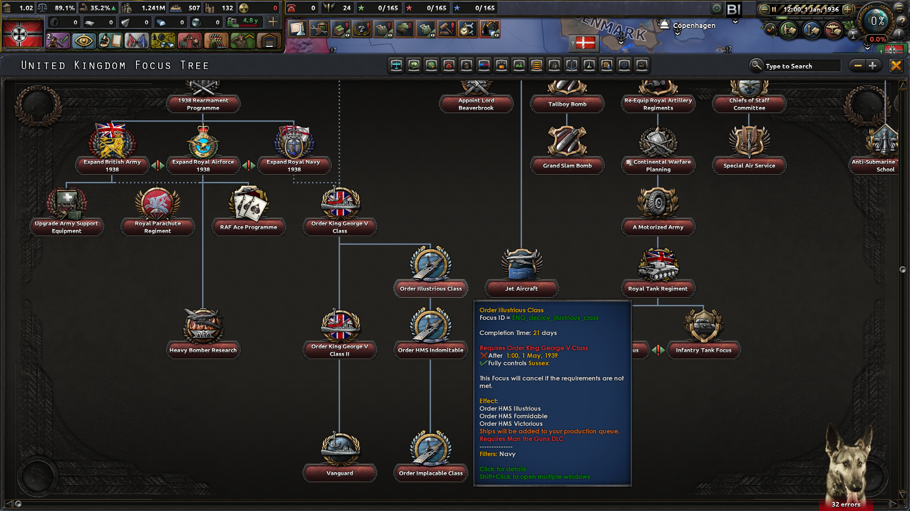


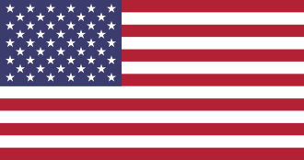
Historical Naval Focuses
Build Historical Ships from Japan, US, and UK.
The AI has been updated to build historical navies using these focuses

Slide 2


